Slide 1



Modeling to make a difference: hydrologic analysis for improved decision support
Abigail Kahler
Ty PA Ferre, PhD
University of Arizona
Arizona Space Grant Consortium
2021 Statewide Symposium
Notes:
Thank you. My research explores how to improve decision-making through hydrologic models.

Slide 2
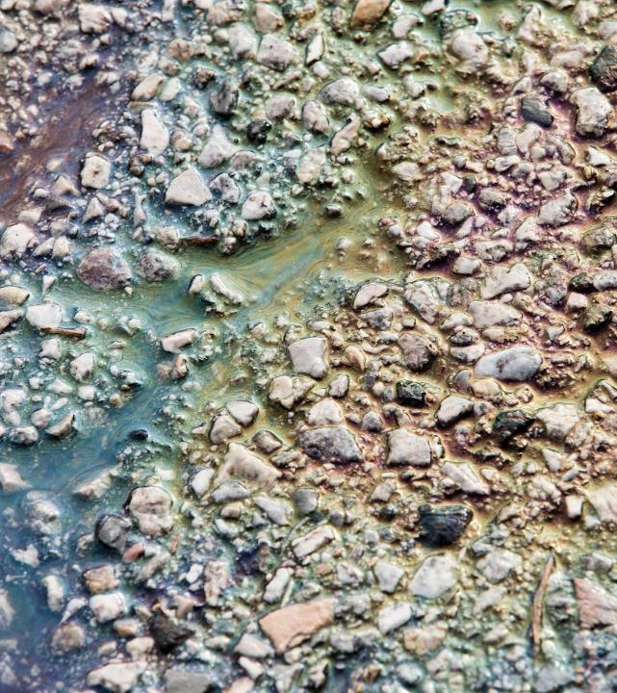
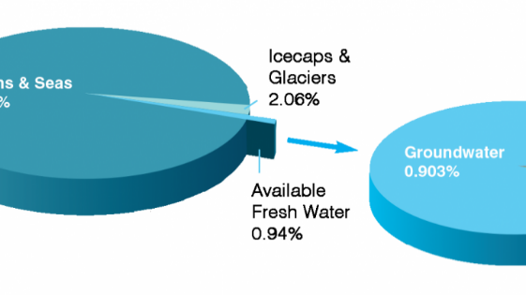



groundwater
2
https://www.un-igrac.org/what-groundwater
https://www.chesapeakebay.net/images/issues/06.17_chemicalcontaminant_issues_image.jpg
Notes:
(My research explores decision-making.)
We are constantly making decisions that are influenced by networks of both internal and external factors. What happens when we don’t consider the bigger picture?
Groundwater makes up the bulk of available fresh water and supports agriculture, industry, and household consumption. It is threatened by overuse and degradation, and does not replenish quickly.

Slide 3
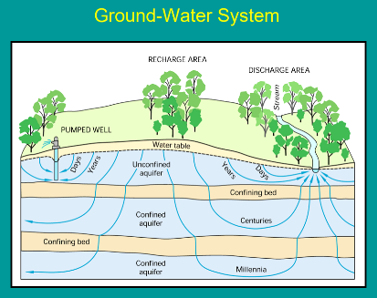
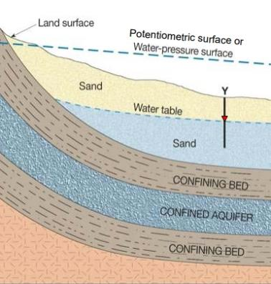
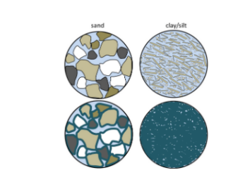
uncertainty
3
1.
1.
1. An Overview of Ground Water in Maryland, Maryland Geological Survey, 2009
2..
2. Earle, S. (2019). Groundwater and Aquifers. In Physical Geology. Creative Commons.
Notes:
Hydrologic models are used to predict the effects of proposed water uses. But, they are limited by insufficient subsurface data. These data provide information about the hydrologic properties, the parameters, that determine the rate and direction of groundwater flow. The tools that are available to describe this uncertainty do not fully consider the risk to decision makers.

Slide 4
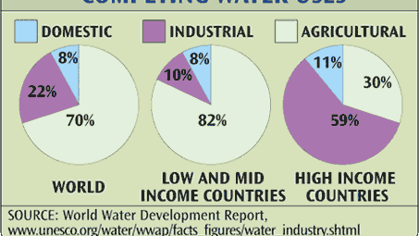
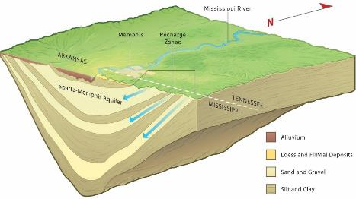


Value
--- risk
4
State vs. State
Industry vs. environment
Agriculture vs. direct consumption
First-Arai, L. (2020). In a cross-state aquifer spat, a view of a water-stressed future.
Notes:
The value of a model to stakeholders, the people or groups making decisions, depends on the level of risk that they are willing to incorporate.
My project considers a general case of two groups with different interests sharing the same water source.
The goal was to design a simple process to represent uncertainty and explicitly evaluate the risk to each stakeholder. I approached this by developing an ensemble of models to iteratively search for the best-fit models in addition to plausible models that would lead to outcomes of concern.

Slide 5
Building The ensemble
5
Velocity
Dispersion
Retardation
Lambda
Parameter space:
Parameter sets
representing subsurface conditions
Notes:
This is an illustration of the starting code: a parameter “space” that houses all models to be considered for the ensemble. Each dot represents a 1D model with four parameters.
One “truth” model was selected to represent measured data.

Slide 6
6
Round 1
Initial
ensemble
Parameter space
Notes:
A first group of models was randomly selected to be the initial ensemble. Then, the contaminant concentration was calculated as a function of time and measured against the “truth model”.

Slide 7
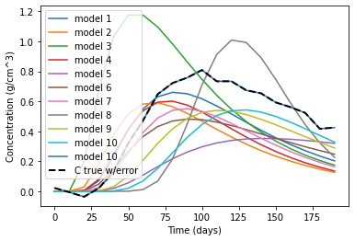
7
Round 1
Initial
ensemble
Parameter space
Notes:
The black dashed line shows the concentration curve of the “truth model” for the measured data. The question is how to find models that fit these data better, without becoming too narrow in focus.

Slide 8
8
Initial
ensemble
Round 1
Good fit
Parameter space
Replacements
Sampled
Notes:
This is the beginning of an iterative selection process.
This initial ensemble is sorted by fit and then another group is considered for replacement.
Only two models are chosen from the new group: One that is the closest to the good-fitting models, and one that is the farthest from all previously sampled. This ensures diverse sampling without losing the previously identified good-fit models.

Slide 9
9
Initial
ensemble
Round 1
Parameter space
Initial ensemble plus selected replacements
Replacements
Sampled
Notes:
The selected replacements are appended to the ensemble and the whole group is sorted by fit. The worst-fitting models are removed, and the process begins again.

Slide 10
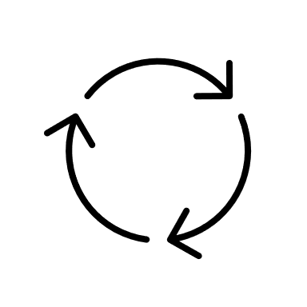
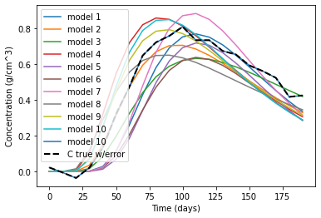
10
Round 1
Refined
ensemble
Parameter space
Notes:
It continues until all the parameter sets have been considered and an improved ensemble is generated.
This represents a range of likely contamination levels at each timestep. What if this refined ensemble contains undesirable outcomes?

Slide 11
Models of concern (moc)
11
Refined
ensemble
Notes:
The undesirable outcomes are identified by user-defined thresholds beyond which there is no value to them.
We’ll call these “models of concern.” The black line represents the cutoff threshold. I want to look more closely at these models because they describe the risk to decision-makers.

Slide 12
12
Round 2 – models of concern
Initial MOC ensemble
Good fit
Previously rejected MOCs
Models not run during Round 1
Replacements
Sampled
Notes:
I repeat the ensemble selection process but, this time, only choosing from parameter sets that have previously been identified as models of concern or were not run in the first round.

Slide 13
13
Round 2 – models of concern
Replacements
MOC?
No
Discard
Notes:
This time, the replacements are only considered if they are a model of concern. This second round is exclusively looking for outcomes that pose a risk to the stakeholder.
If a selected replacement is not an MOC it is discarded. Otherwise, it is appended to the initial ensemble.

Slide 14
14
Round 2 – models of concern
Replacements
Initial MOC ensemble
plus selected replacements
Best-fit
MOCs
MOC?
Yes
Append
No
Discard
Notes:
The models are sorted and the worst-fitting are removed. The process continues until the best-fitting MOC’s have been identified and we have an ensemble composed entirely of plausible models of concern to investigate the risk to the stakeholder.

Slide 15
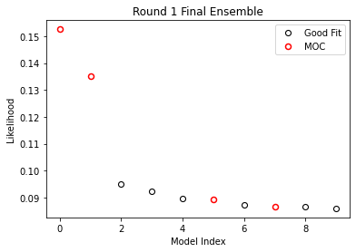
likelihood
15
Round 1 criteria
Diverse sampling
Best fit to data
Notes:
Now we take a closer look at the likelihood of the models from the first round. This plot is sorted by greatest likelihood with the corresponding model index number. The black circles represent desirable outcomes, and the red are models of concern.

Slide 16
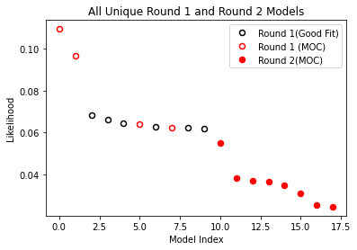
likelihood
16
Round 1 criteria
Diverse sampling
Best fit to data
Round 2 criteria
Diverse sampling
Models of concern
Best fit to data
Notes:
Then both rounds are combined, and the likelihoods are recalculated. The solid red circles are models of concern from the second ensemble.
These models have a lesser fit to the data but are of greater concern, and can be used to inform future data collection.

Slide 17
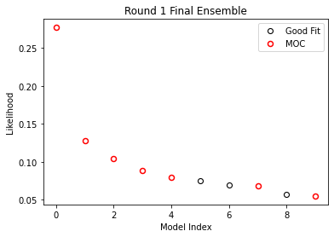
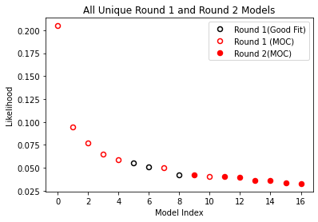
Preliminary observations
17
Truth model:
MOC
Notes:
I am also exploring whether the truth model being an MOC itself affects the process.

Slide 18
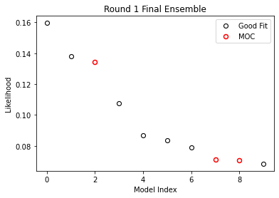
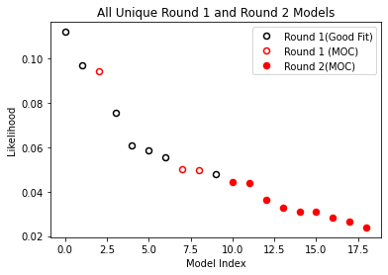
Preliminary observations
18
Truth model:
MOC
Truth model:
not MOC
Notes:
Generally, the combined likelihoods have similar behavior in each case. So far, the results do not seem dependent on whether the truth model is an MOC.

Slide 19
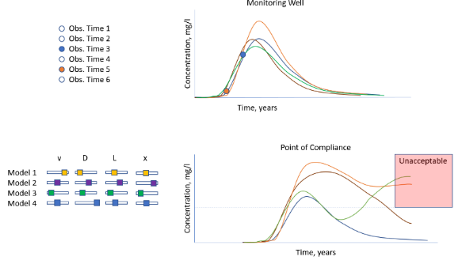
Summer 2021
19
Notes:
This project is a very simple example of the value of combining goodness-of-fit and importance-based calibration. The challenge is to make this efficient for complex models. Next steps will incorporate a stakeholder utility function, and this summer’s work will be to develop an interactive app to introduce this process to decision-makers.

Slide 20


acknowledgements
20
Ty PA Ferre, University of Arizona Distinguished Professor, Hydrology and Atmospheric Sciences
UA/NASA Space Grant program and staff
UA Hydrology and Atmospheric Sciences Department

Slide 21
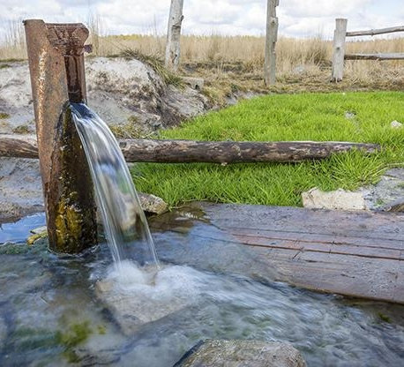
thankyou
21
https://www.eenorthcarolina.org/resources/your-ecological-address/groundwater

